Slide 1
BREAULT SWD TRAINING
Date: Sept 16th, 2024
Attendance: John chu, tom Brixey, jon Herlocker, and pam james
Goal: Explain how to in’s and out’s of github in breaultswd org.

Slide 2
Github navigation
Briefly before we navigated through GITHUB. This serves as a refresher.

Slide 3
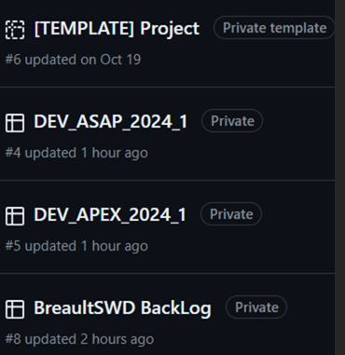
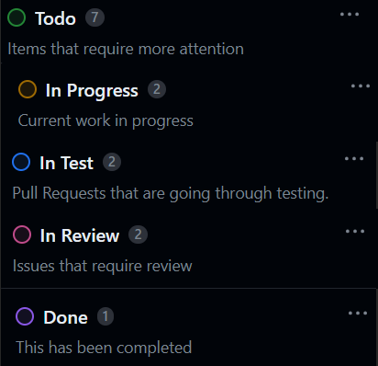
Projects

Slide 4
Repository
Only the DEV_ repo’s shall have Issues associated.
No development shall be done directly on the BreaultSWD repo’s
All development shall be on forks
All test cases shall be in associated Test_Repo

Slide 5
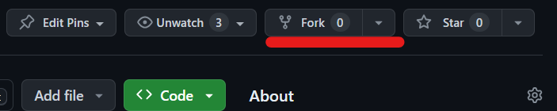
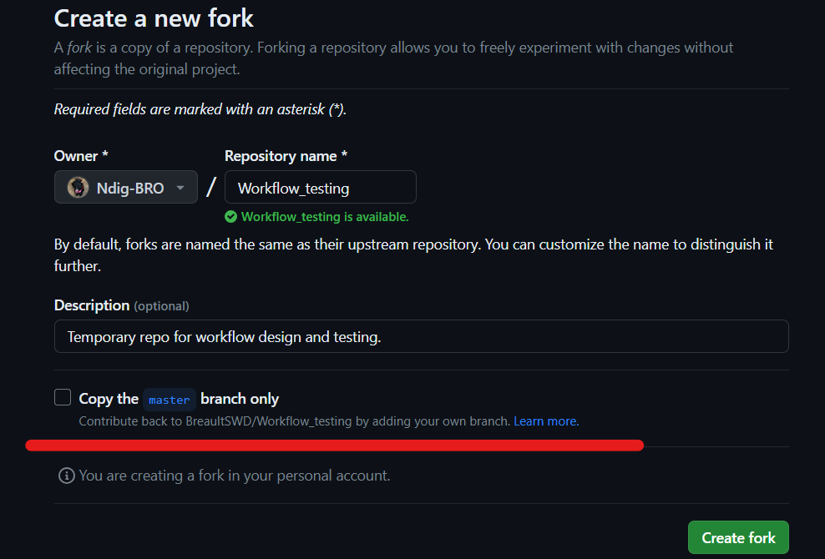
Creating a new fork

Slide 6
Issues
Shall be from the back-log > moved to Current Development
Shall be associated to a DEV_ project
Shall be created on a DEV_ branch
Developer shall not close out issue without review
The reviewer shall close out the issue
Development shall be linked with a pull-request

Slide 7
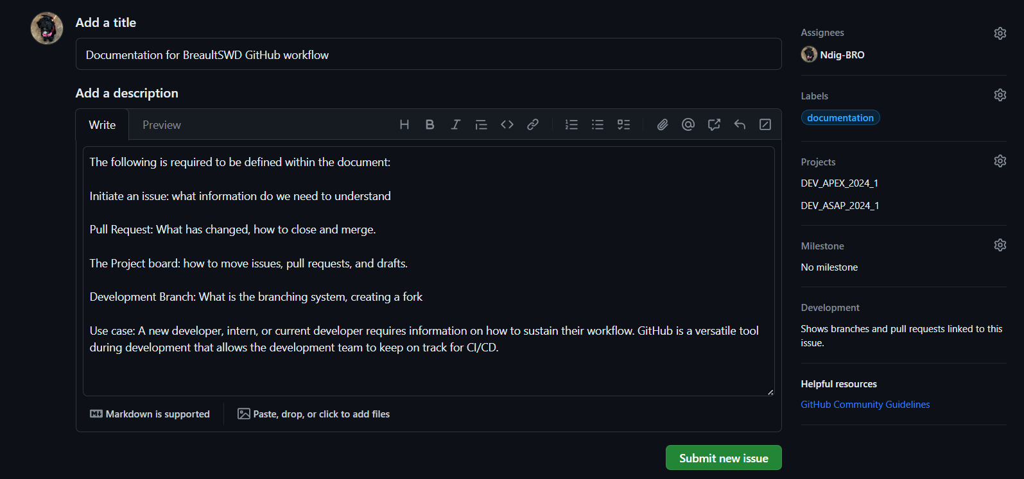
Issues

Slide 8


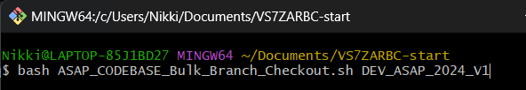

Obtaining the codebase bash files
Bash repo_clone first
Bash bulk_branch <DEV_ branch>
NOTE: this pulls from BreaultSWD and does not create a link to upload

Slide 9
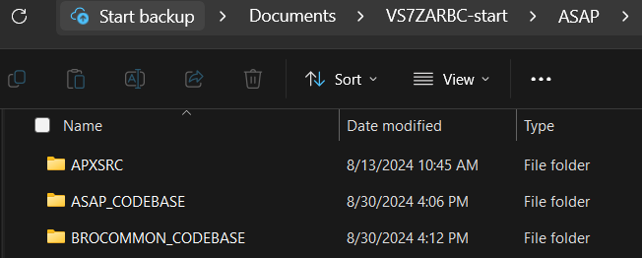
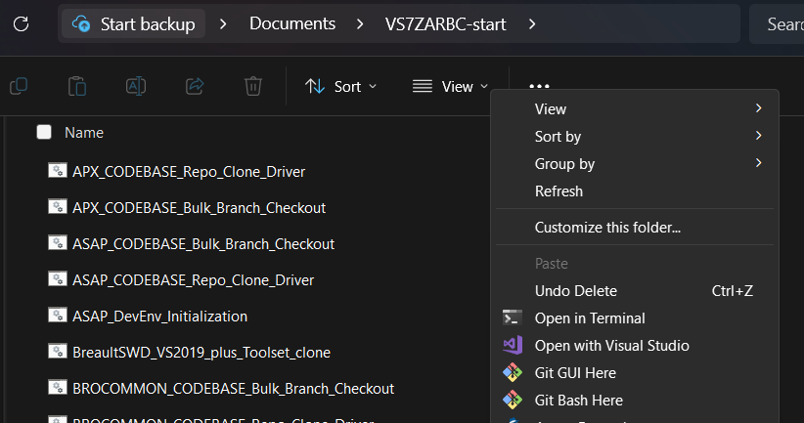
Bash scripts to call for new development
Delete the files within and keep the main folders
From VS7ZARBC call a git bash here

Slide 10
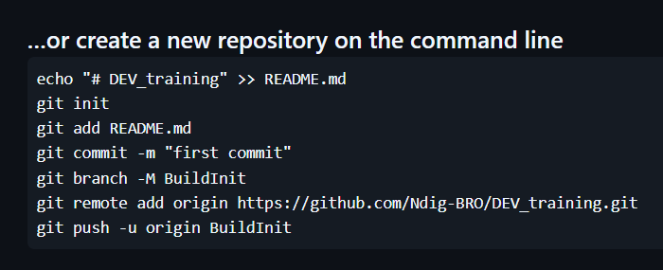
Commits in bash
git init -b <name of the local branch>
Git checkout -b <name of branch>
Add the files to your current local Branch:
git add .
git commit -m “<DEV_note>”
git remote add <name> <URL fork link>
git push <remote> <branch>

Slide 11
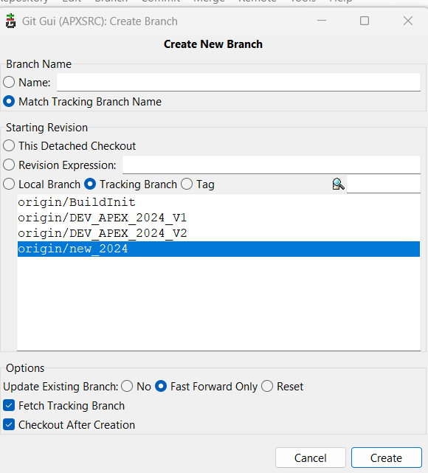
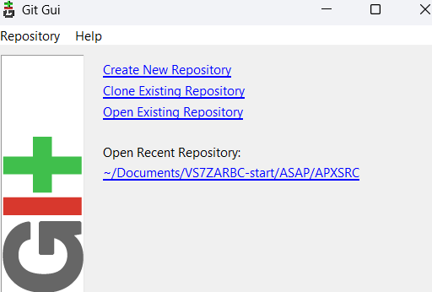
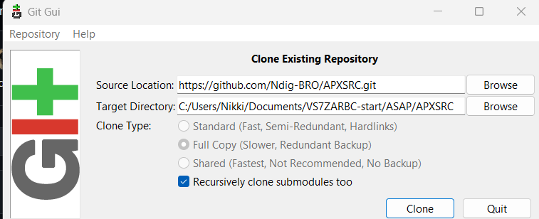
Cloning in git gui
NOTE: The last /APXSRC folder cannot exist in clone

Slide 12
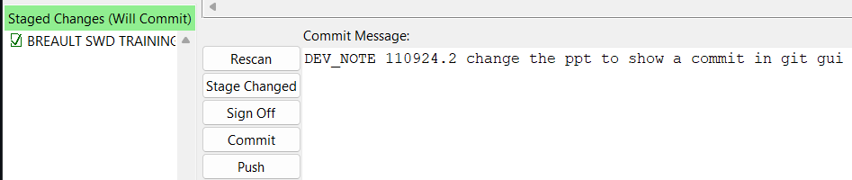
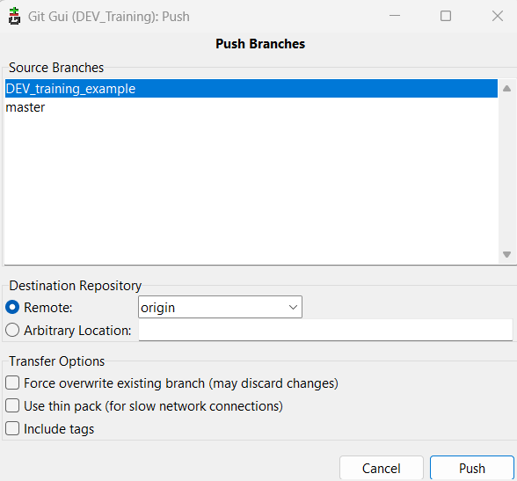
Commits in git gui

Slide 13
Zip download from github

Slide 14
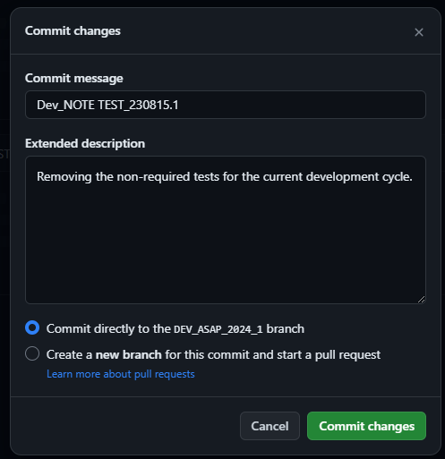
Commits in github

